Slide 1

Team bhid
Queue Management App
-Phurba Sherpa
-Mohammad Imran Samir
-Bhim kumari magar
-Shreejal dahal
-Sandip sah

Slide 2
Problem Statement
Long queues and increasing citizen
Attending citizen queries fast without compromising on the different pandemic regulations is also a challenge.
Most difficult for senior & handicapped citizens.
Others work being left out.
Increase in corruption.
Online Token offers a powerful solution against Covid 19, while also protecting consumers' health and hygiene.

Slide 3
Current scenario of token system in Nepal
Research
The Ministry of Physical Infrastructure Development has agreed to offer online token.(kasi.s 17th october 2020 The Rising Nepal)
Samsung Nepal has introduced an online appointment system based on a token system.(sanjeev 16th August 2020 Gadgebyte Nepal)
Nepalgunj-based Land Reform and Land Revenue Offices started token system to provide fast service to service seekers in Banke.(HIMALAYAN NEWS SERVICE, Feb 09, 2021)

Slide 4

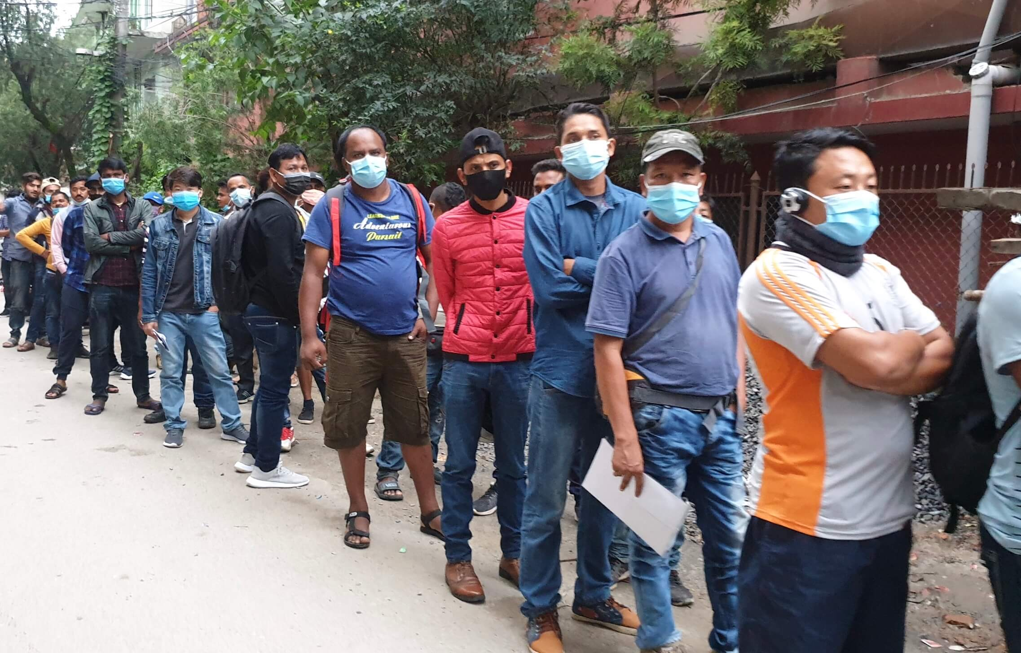

Slide 5
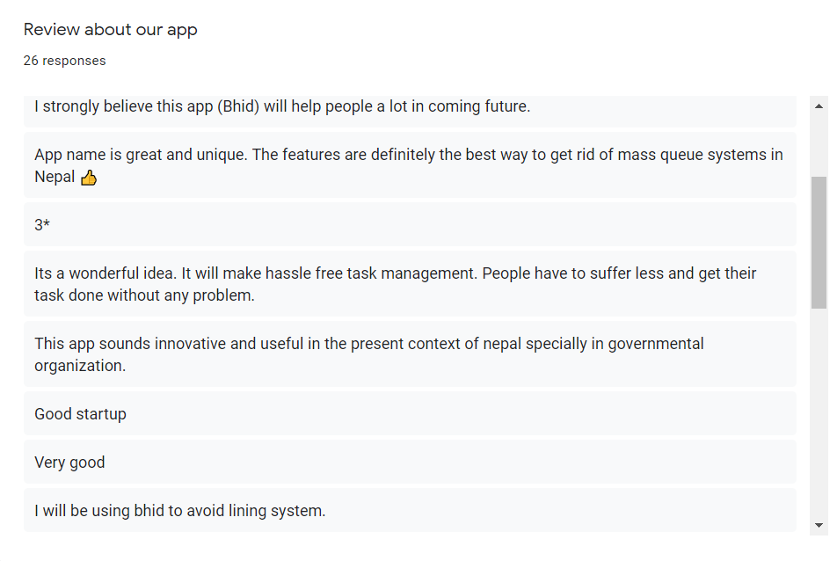
Survey
The traditional rush and lengthy lines can't be used because of the risk of becoming infected. Smart queue management system using Online token is an essential instrument to be utilized during the Pandemic crisis all over the world. So we are doing this survey to know the people views on our APP and the online token system.

Slide 6
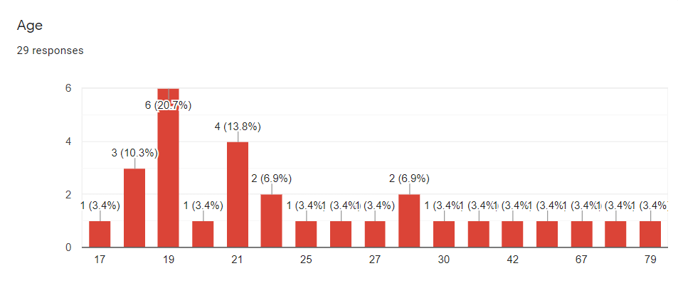
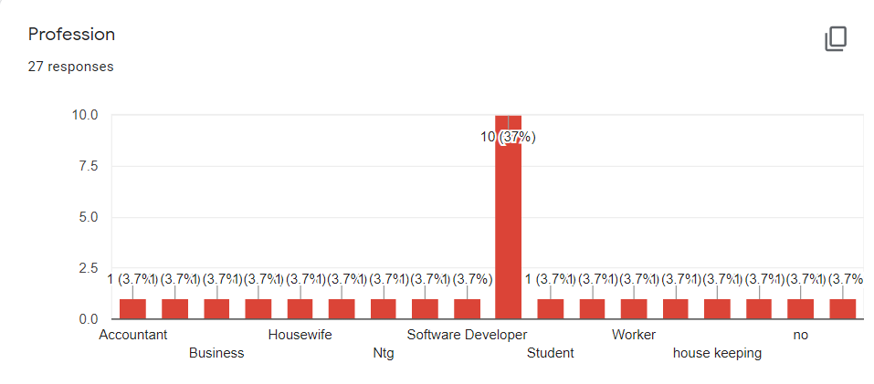

Slide 7
Features:
Minimize contact touch point by using mobile or virtual queuing solutions.
Simple app which can be used by all the citizens.
Inbuilt speaker & microphone for incapable users.
App with Multi-language
Digital appointment/ token in a click
Live status of token generated
Location (extension from Google maps)

Slide 8
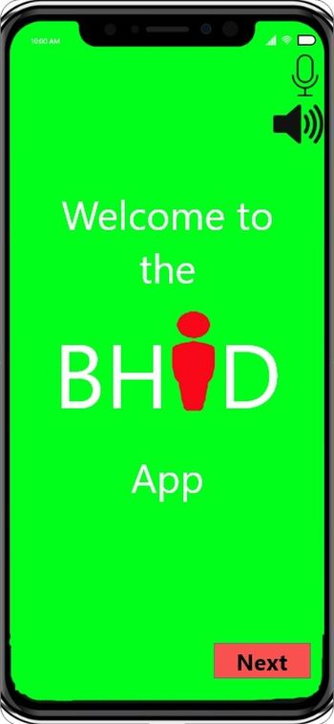
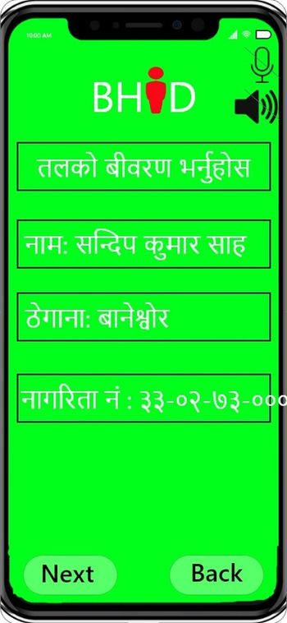
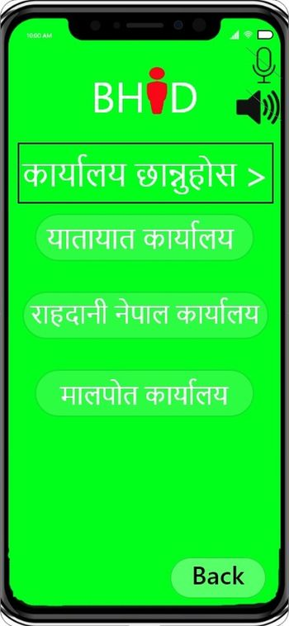
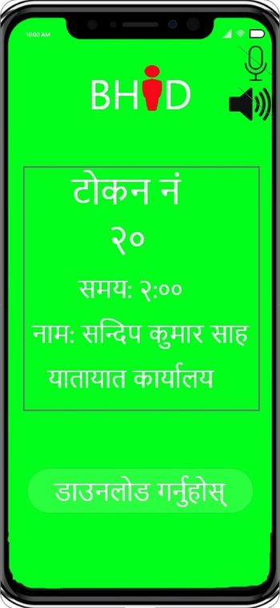
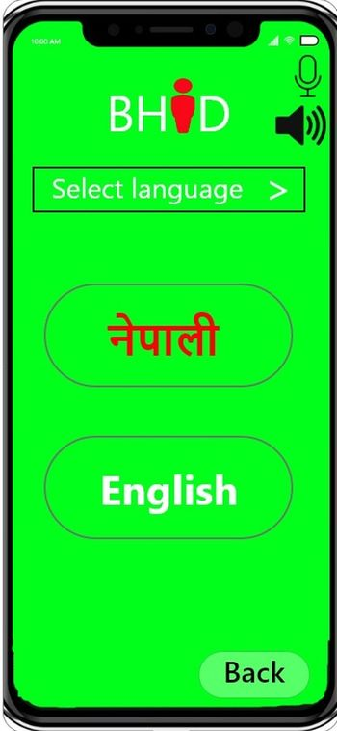
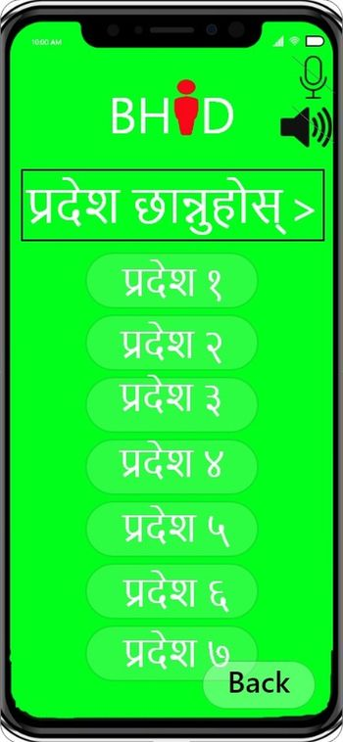

Slide 9
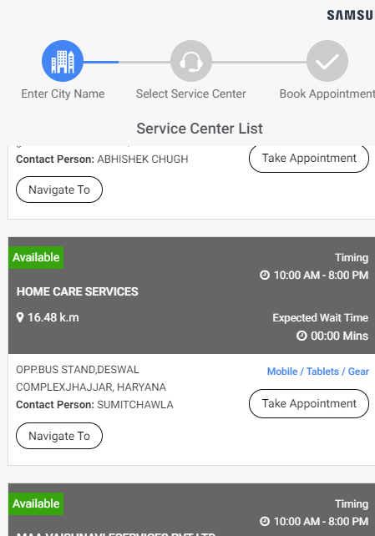
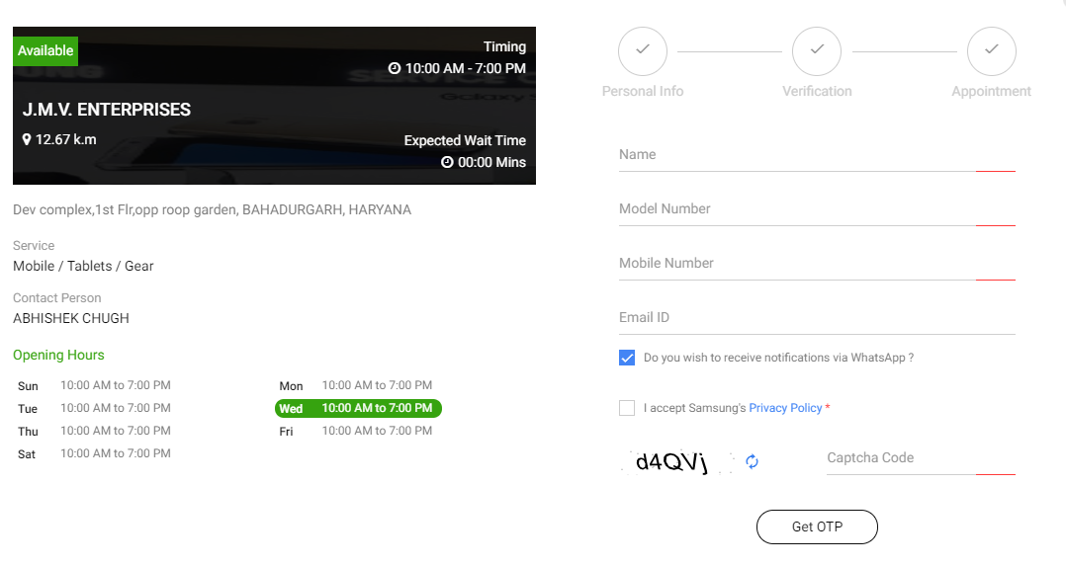
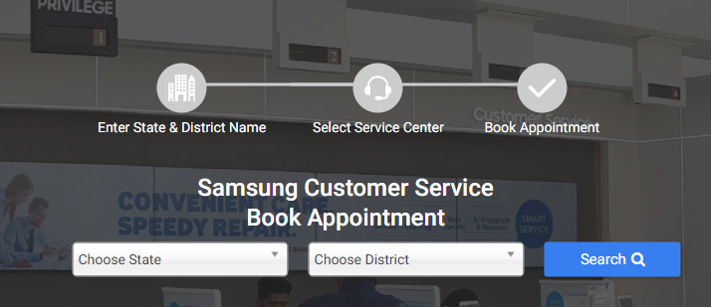
example online token system

Slide 10
WORK MANAGEMENT
S.N. | MEMBER | WORK ALLOTED
1 | BHIM KUMARI MAGAR | Presentation & Research
2 | PHURBA SHERPA | Presentation & Research
3 | MOHAMMAD IMRAN SAMIR | Survey
4 | SANDEEP SHAH | Prototype
5 | SHREEJAL DAHAL | Presentation & Research

